Slide 1
AI Image Restoration for 5G Edge Systems Lightweight Hybrid CNN–Transformer for Real-Time Reconstruction Efficient • Real-Time • Edge-Ready
Inderjit Singh
M.Tech (AI), IISc Bangalore
Mentor: Prof. Shashi Jain (IISc)
BT Group: Micheal Free, Damien Bayart
Notes:
My name is Inderjit Singh, and today I will be presenting my Master's project titled “AI Image Restoration for 5G Edge Systems’
This work was completed under the guidance of Professor Shashi Jain, and my internal guide at BT Group, Micheal Free and Damien Bayart.

Slide 2

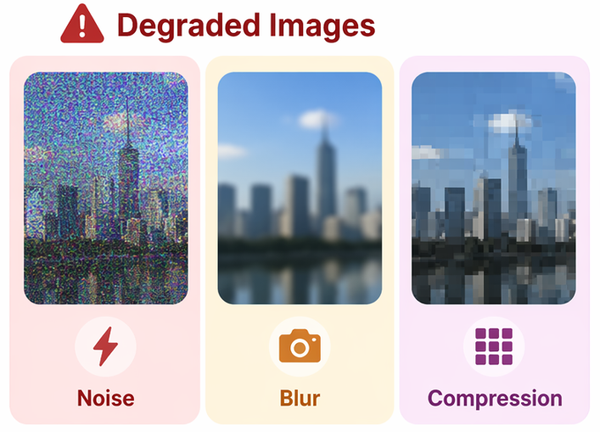
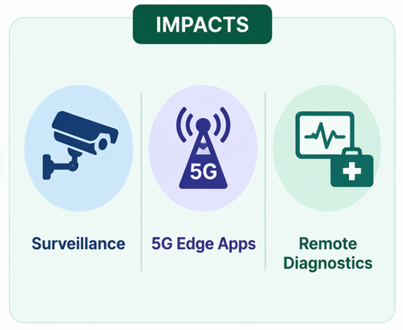
The Problem in the Real World
Notes:
“Imagine you’re looking at a live camera feed from a busy city.
At first, everything seems fine… but then reality kicks in.
On the left, you see what actually happens in the real world. Images are rarely perfect. Sometimes the camera sensor introduces noise, especially in low light—like that grainy image you see here. Other times, motion or focus issues cause blur, making important details unclear. And when we transmit images over networks, especially in bandwidth-limited scenarios, we apply compression, which leads to blocky, pixelated outputs.
Now think about where these images are used.
In surveillance, missing a small detail could mean missing a critical event. In 5G edge applications, decisions need to be made instantly—but poor image quality affects accuracy. And in remote diagnostics, especially in healthcare, unclear images could directly impact decisions and outcomes.
So the problem is not just about image quality—it’s about trust, accuracy, and real-world consequences.
That’s the gap we’re trying to address.”

Slide 3
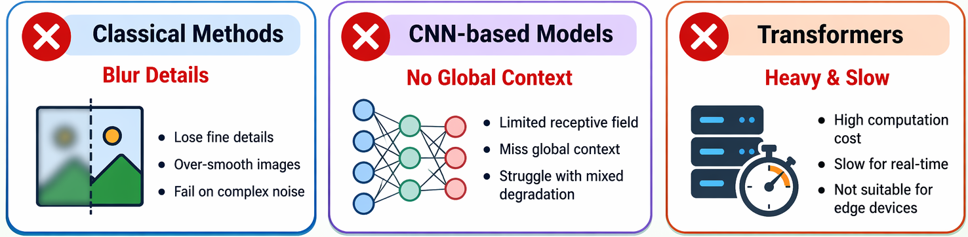

Why Current Solutions Fall Short
Notes:
Now that we’ve seen the real-world problem, the next question is—why can’t existing methods solve it?
Let’s start with classical methods. These approaches try to remove noise or blur, but in doing so, they often over-smooth the image. So yes, noise is reduced—but we also lose important fine details. And when the degradation is complex, they simply don’t perform well.
Then came CNN-based models, which improved results significantly. But they have a key limitation—they focus on local regions. That means they miss the bigger picture, or the global context, which is crucial when dealing with mixed degradations like noise + blur + compression together.
On the other hand, Transformers do capture global context very well. But this comes at a cost—they are computationally heavy and slow. This makes them impractical for real-time applications, especially on edge devices like mobile or IoT systems.
So when we step back and look at all three, a clear research gap appears.
We don’t have a model that is:
Lightweight
Can handle multiple degradations simultaneously
And still works efficiently on 5G edge devices
And that’s exactly what motivates our work— to design an efficient and scalable image restoration model that can actually be deployed in the real world.”

Slide 4
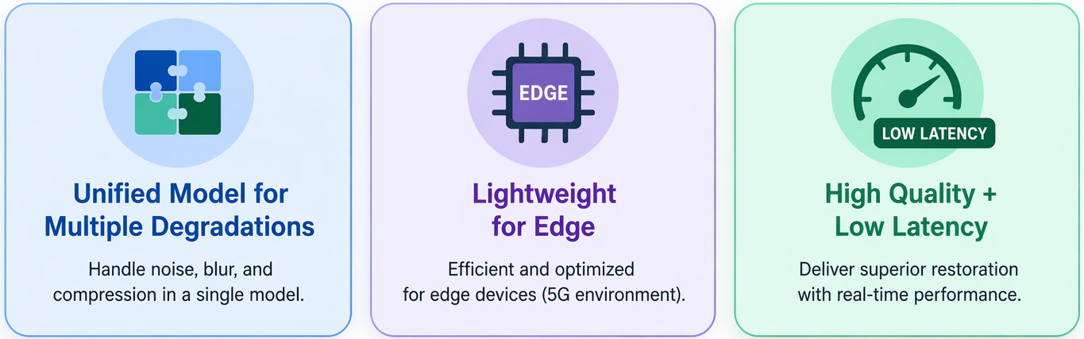
Objectives
GOAL: Design an efficient image restoration model for real-world applications.
💡 Efficient, real-time image restoration for multi-degradation scenarios on edge devices.
Notes:
Based on the gaps we just identified, we can clearly define our objectives.
Our main goal is simple— to design an efficient image restoration model that works in real-world conditions.
To achieve this, we focus on three key objectives.
First, instead of building separate solutions for each problem, we aim for a unified model—one that can handle multiple degradations like noise, blur, and compression all at once. Because these issues don’t occur in isolation.
Second, the model must be lightweight and optimized for edge devices. Since many applications run on mobile or 5G edge environments, we can’t rely on heavy models that require high computational power.
And third, we target a balance between high quality and low latency. It’s not enough to just improve image quality—the model must also deliver results in real time.
So overall, our objective is to build a system that is not only accurate, but also practical, efficient, and deployable—especially for real-world, multi-degradation scenarios on edge devices.”

Slide 5
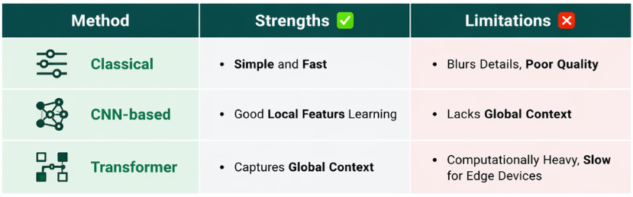

Literature Review
Existing Methods Comparison
Notes:
“Before proposing our solution, we looked at what existing methods offer and where they fall short.
Starting with classical methods—they are simple and fast, which makes them easy to use. However, they tend to blur important details, resulting in poor image quality, especially in complex scenarios.
Next, CNN-based models improved performance by learning local features very effectively. But their limitation is that they lack global context, which becomes a problem when dealing with multiple degradations at the same time.
Then we have transformer-based models, which address this issue by capturing global context. This significantly improves restoration quality. However, the downside is that they are computationally heavy and slow, making them unsuitable for edge devices and real-time applications.
So, when we compare all these approaches, a clear gap emerges.
There is currently no lightweight model that can handle multiple degradations simultaneously and still run efficiently on 5G edge devices.
This gap directly motivates our work and defines the direction of our proposed solution.”

Slide 6
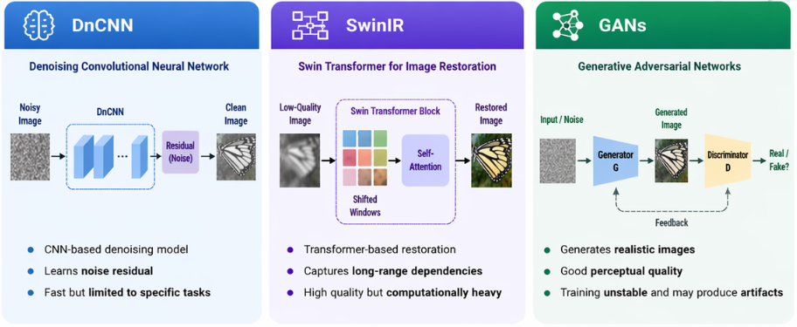
Literature Review
Key Deep Learning Models
Notes:
“Let’s look at the key deep learning models used in modern image restoration.”
We start with DnCNN, which is a convolutional neural network designed specifically for denoising. Instead of directly predicting a clean image, it learns the noise pattern—what we call the residual—and subtracts it from the noisy input. This makes it fast and efficient, but it works best when the type of noise is known and consistent. So, it’s powerful, but somewhat limited in flexibility.
0
Next, we move to SwinIR, which is based on transformers. Unlike CNNs, it uses self-attention mechanisms to capture long-range dependencies across the image. This means it understands both local textures and global structure much better. As a result, it produces high-quality restoration, especially for complex degradations. However, this comes at the cost of higher computational complexity.
Finally, we have GANs, or Generative Adversarial Networks. These consist of two components: a generator, which creates images, and a discriminator, which evaluates whether they are real or fake. This adversarial setup allows GANs to produce very realistic and perceptually sharp images. But training them can be unstable, and sometimes they introduce unwanted artifacts.
“So overall, we see a clear progression:”
DnCNN → fast and simple
SwinIR → powerful and accurate
GANs → highly realistic but complex
“Each model has its own trade-offs between speed, quality, and stability, and choosing the right one depends on the application.”

Slide 7

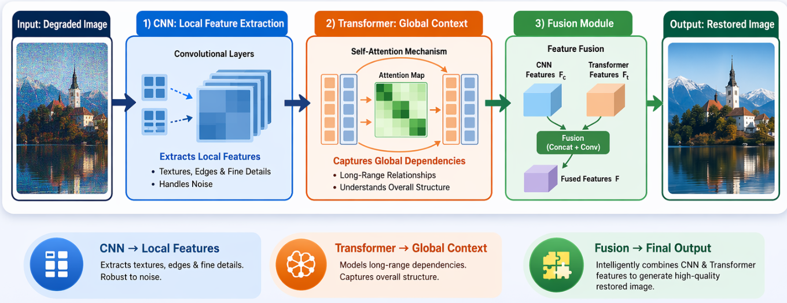

Proposed Solution
Hybrid CNN + Transformer for Image Restoration
Notes:
Step 1: CNN – Local Feature Extraction First, the image is passed through a CNN. The CNN focuses on local details such as textures, edges, and fine structures. It is especially effective at handling noise and preserving important low-level features.
Step 2: Transformer – Global Context Understanding Next, these features are fed into a Transformer module. Using self-attention, the Transformer captures long-range dependencies across the image. This allows the model to understand the overall structure and global relationships, which CNNs alone may miss.
Step 3: Fusion Module Then, we combine the strengths of both components. The fusion module integrates CNN features (local) and Transformer features (global). This step ensures that the final representation contains both fine details and holistic context.
Output: Restored Image Finally, the fused features are used to reconstruct a high-quality restored image, with reduced noise and improved clarity.
“So the key idea here is simple but powerful:” CNN provides local precision, Transformer provides global understanding, and their combination results in superior image restoration performance.

Slide 8
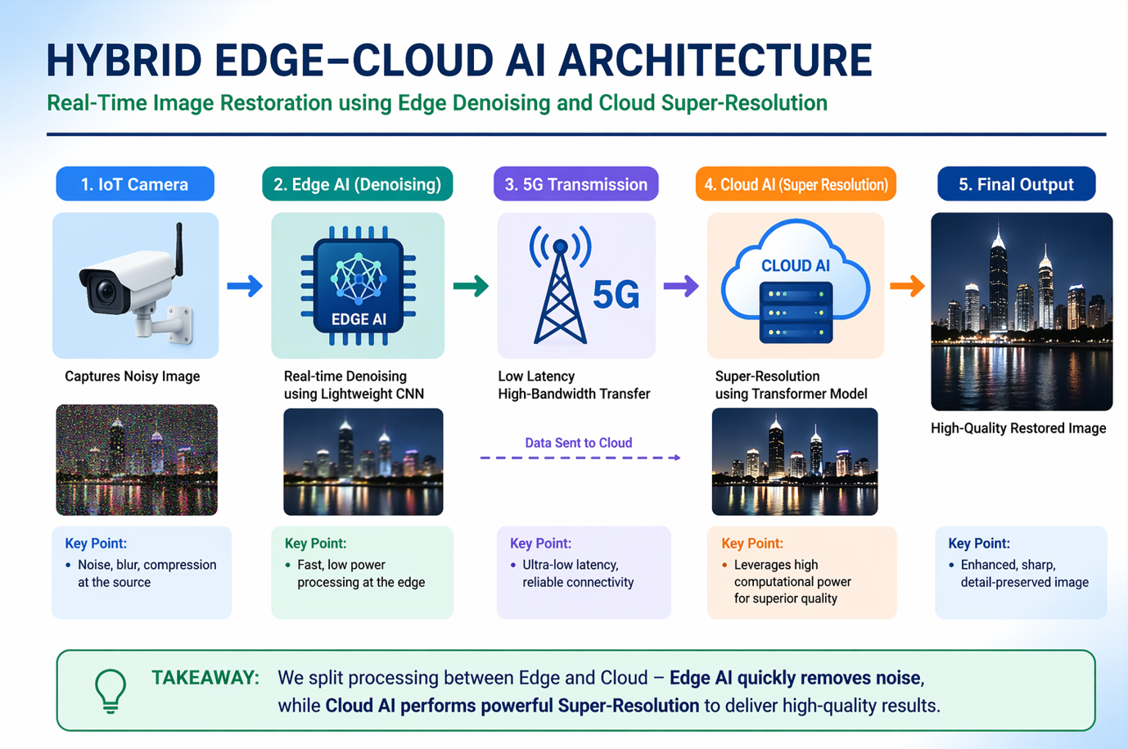

Slide 9
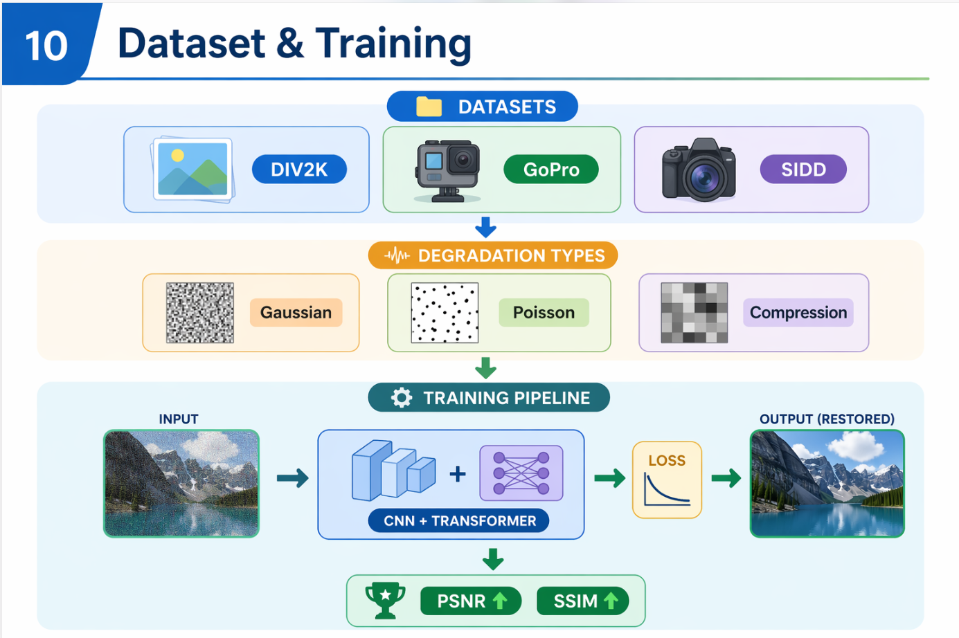

Slide 10
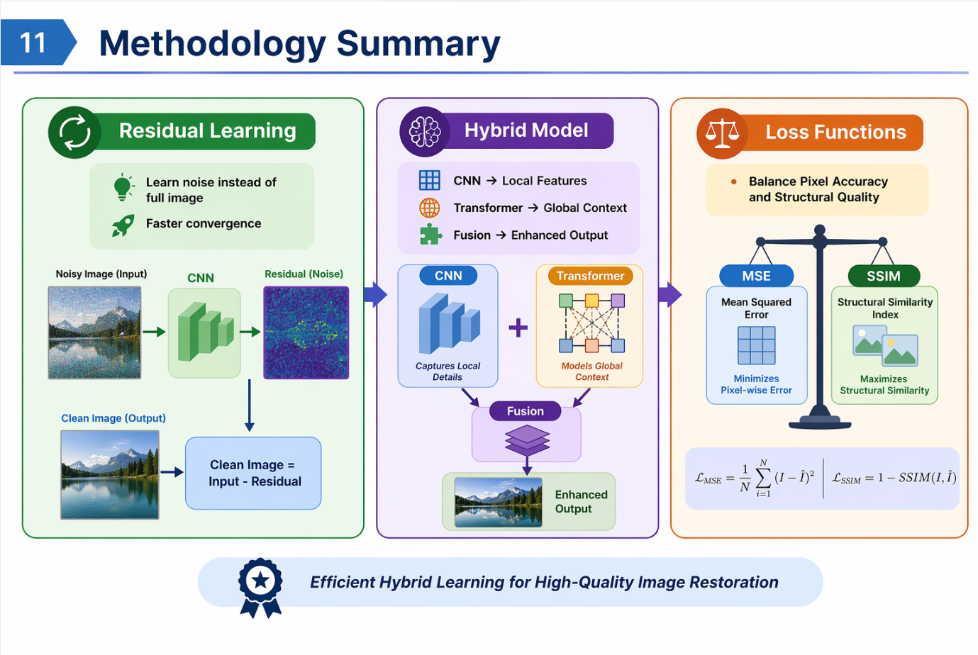

Slide 11
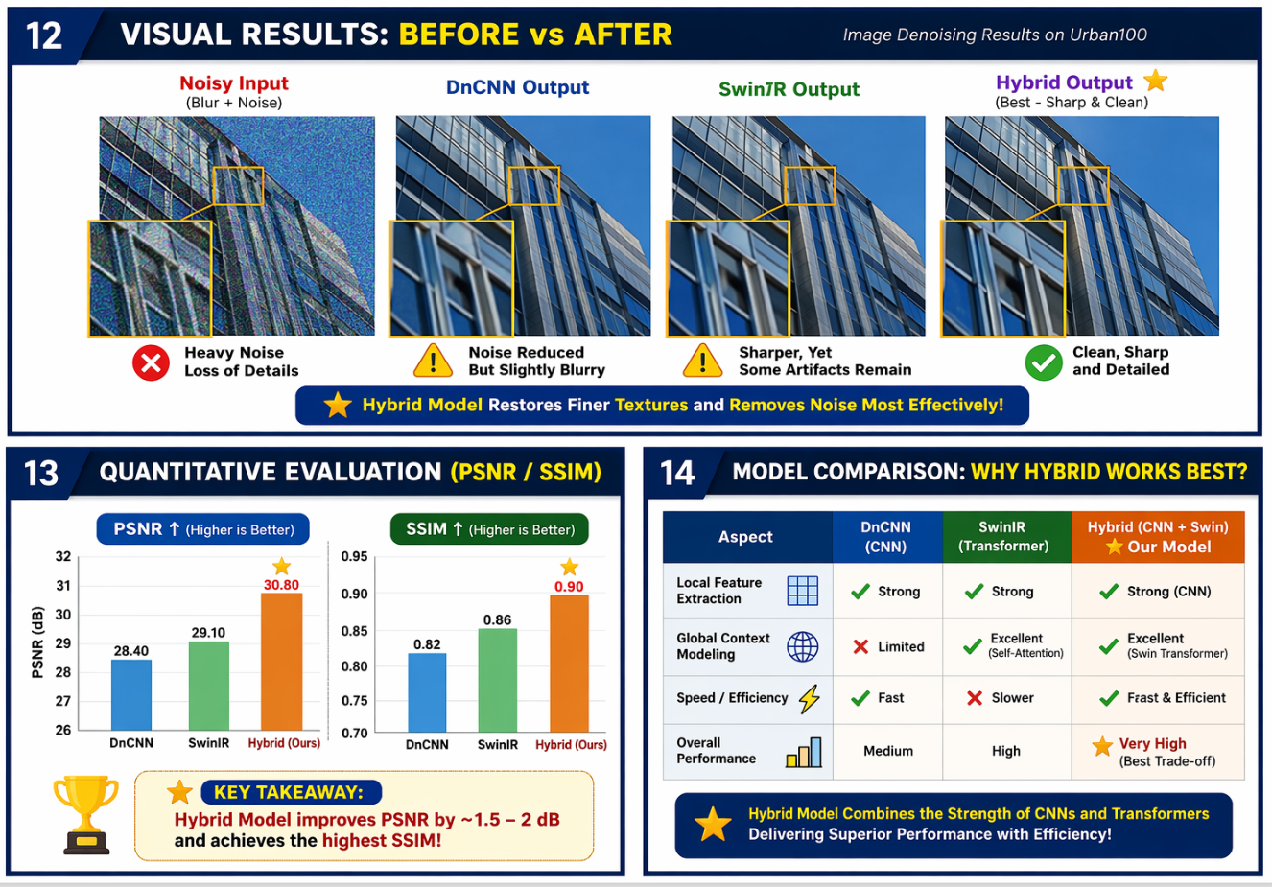

Slide 12
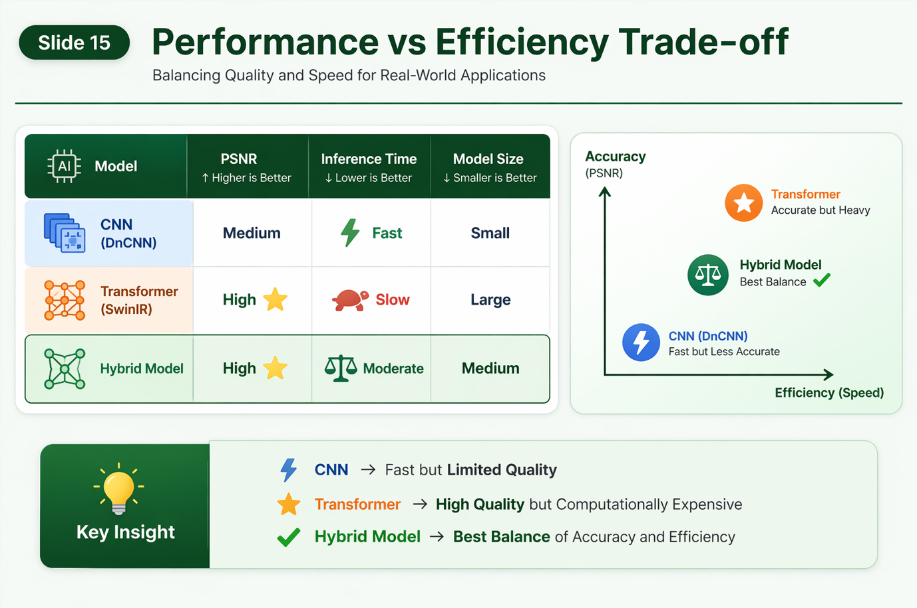

Slide 13


Slide 14
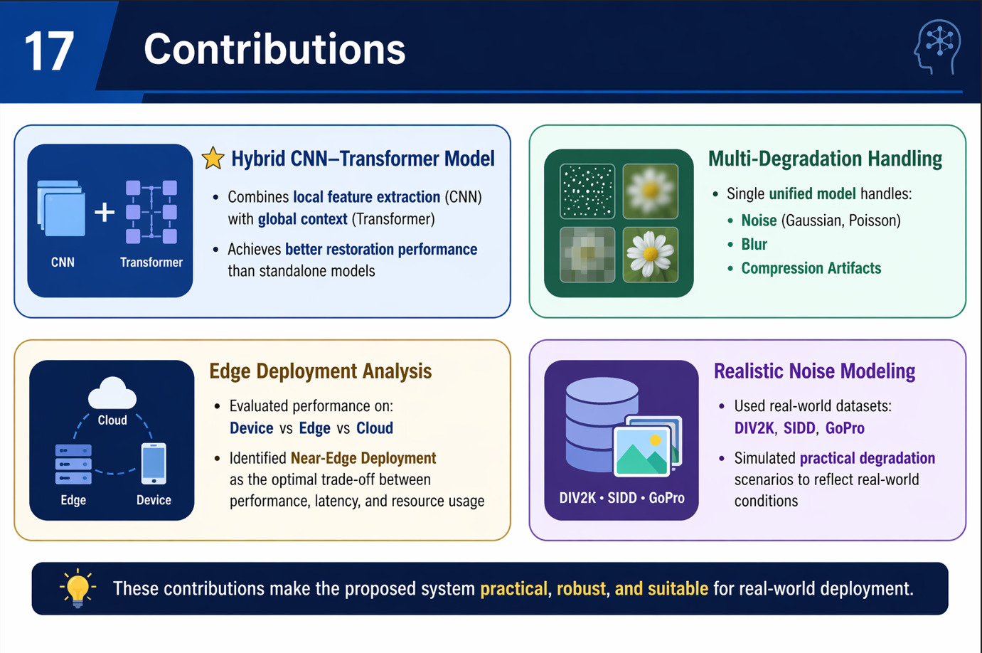

Slide 15
Thank You
© British Telecommunications plc 2023

Slide 16

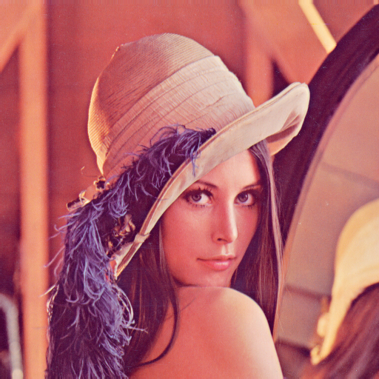
The Problem in the Real World
“A security camera at a 5G edge node sends compressed images to save bandwidth. When the image reaches the control center — it’s noisy and blurry. How can AI fix that?”
AI

Slide 17
Why It Matters
Main idea: Poor image or video quality isn’t just inconvenient — it affects how we see, decide, and trust.
Key points:
Surveillance: Clear visuals mean accurate identification and faster response.
AR/VR: Enhances immersion and realism for training, gaming, or design.
Remote Diagnostics: Doctors, engineers, or technicians rely on clarity to make correct calls.
Everyday impact: From video calls to smart cameras, better quality = better communication.
Emotional connection:
Clarity → Trust → Safety → Better Experience

Slide 18
Context: Challenges in the 5G–Edge World
1. Bandwidth Limits
Smart cameras and IoT devices compress data to save bandwidth. AI-based restoration recovers clarity from these lightweight transmissions.
2. Low-Latency Needs
Real-time tasks such as surveillance and diagnostics require instant visuals. Edge restoration ensures fast and accurate image processing.
3. Network Optimization
Devices can send smaller, degraded images instead of high-resolution ones. AI restores visual quality at the receiver, reducing network strain.
4. Visual Experience
AR/VR, streaming, and video calls lose quality due to compression. Restoration improves realism and user experience without extra bandwidth.
5. Remote Operations
Engineers depend on transmitted visuals for diagnostics and maintenance. Restoration enhances clarity, reducing errors and on-site visits.
Notes:
.

Slide 19
Business Case: Image Restoration + Super-Resolution in IoT over 5G
Aspect | Details
Business Problem | IoT devices transmit images/videos over 5G that suffer from compression, noise, and packet loss, leading to degraded quality. This reduces AI analytics accuracy, impacts critical decision-making (healthcare, surveillance, autonomous vehicles), and degrades end-user experience.
Objectives | • Deliver high-quality, high-resolution images to end users • Ensure reliable AI analytics with clean input data • Minimize latency and processing cost at edge servers • Improve trust, safety, and operational efficiency
Key Challenges | • Network constraints: bandwidth limits, unstable 5G connections • Real-time requirements for monitoring and control • Scalability: millions of IoT devices streaming continuously • Balancing cost vs. image quality in edge processing
Opportunities / Business Value | • Smart Cities → Safer surveillance with clearer CCTV feeds • Healthcare → More accurate telemedicine & remote diagnosis • Autonomous Vehicles → Better road safety & navigation decisions • Industrial IoT → Enhanced monitoring reduces downtime & failures

Slide 20
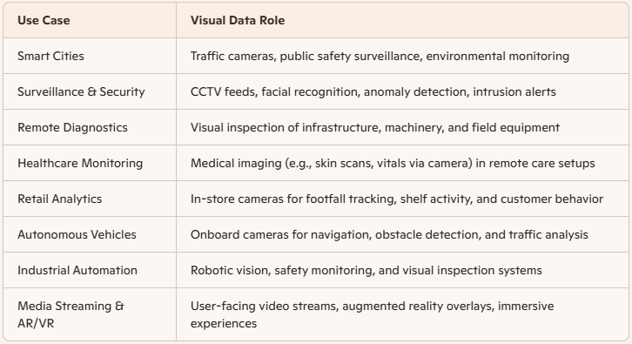
Use Cases & Visual Data Roles

Slide 21





IOT Devices
5G/Network
User/Application
Edge AI
Cloud AI
Example Workflow
IoT Camera captures a noisy image.
Edge AI performs quick denoising + enhancement.
Sends partially restored image over 5G to the cloud AI.
Cloud AI performs advanced super-resolution + final restoration.
User Application receives a high-quality, restored image.

Slide 22
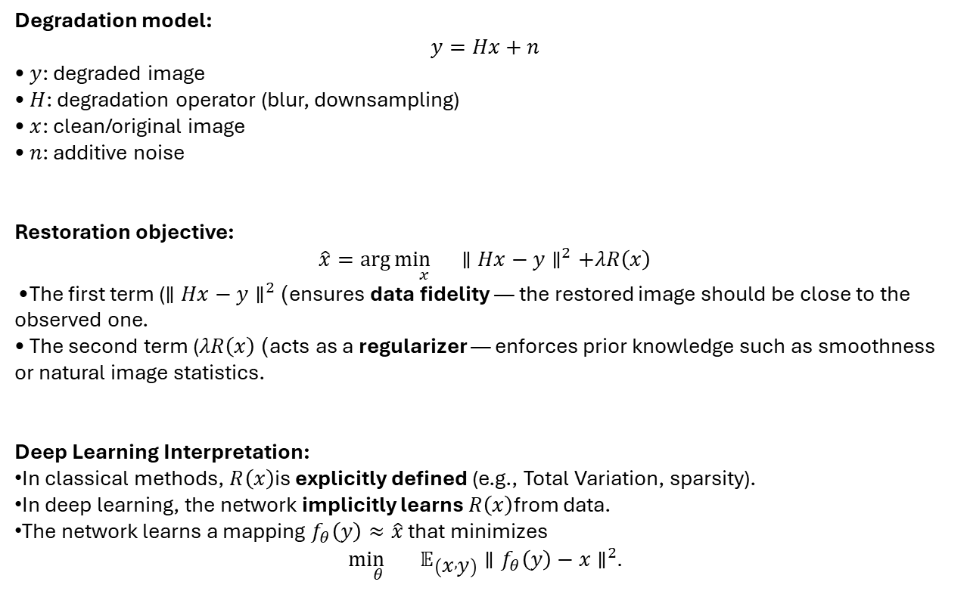
Mathematical Problem Formulation
Degradation model:
$$y=Hx+n$$
• $y$: degraded image • $H$: degradation operator (blur, downsampling) • $x$: clean/original image • $n$: additive noise
Restoration objective:
$$\hat{x}=\arg{\underset{x}{\min{}}}∥Hx−y∥^{2}+λR\left(x\right)$$
• The first term ($∥Hx−y∥^{2}$) ensures data fidelity — the restored image should be close to the observed one. • The second term ($λR\left(x\right)$) acts as a regularizer — enforces prior knowledge such as smoothness or natural image statistics.
Deep Learning Interpretation:
In classical methods, $R\left(x\right)$is explicitly defined (e.g., Total Variation, sparsity).
In deep learning, the network implicitly learns $R\left(x\right)$from data.
The network learns a mapping $f_{θ}\left(y\right)≈\hat{x}$ that minimizes
$$\underset{θ}{\min{}} 𝔼_{\left(x , y\right)}∥f_{θ}\left(y\right)−x∥^{2}.$$

Slide 23
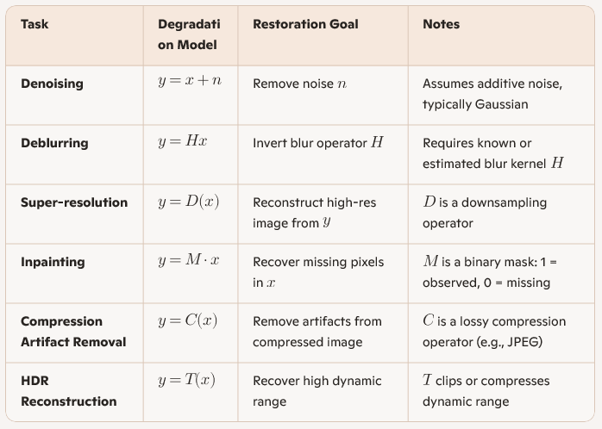
Restoration Tasks — Mathematical View
(Zhang et al., 2017)./Multiple

Slide 24
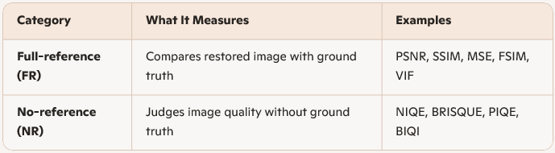
Two Main Types of Image Quality Metrics

Slide 25
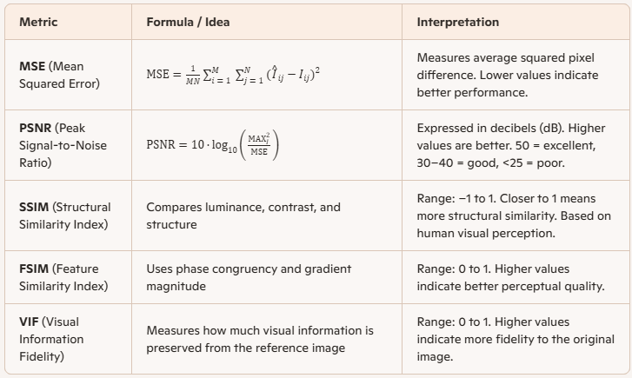
Full-Reference Image Quality Metric

Slide 26
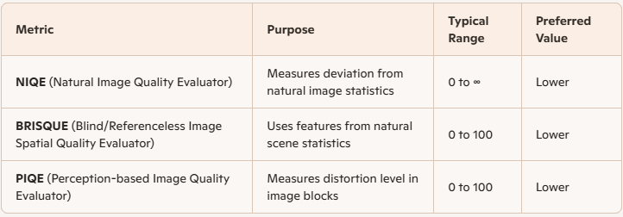
No-Reference Image Quality Metrics

Slide 27
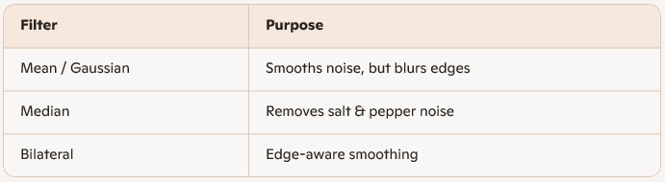
Classical Image Restoration – The Filter Era
Objective: Restore clarity using mathematical filters — no learning involved.
Common Filters
Limitations
Blurs fine details
Weak on complex or structured noise
Requires manual tuning
Legacy
Foundation for model-based (TV) and learning-based (DnCNN, UNet) methods
Still useful for preprocessing and benchmarking
“Classical filters clean images — but at the cost of sharpness.”

Slide 28
Classical Image Restoration Methods
Spatial Domain Methods
Operate directly on pixel values.
Filtering techniques:
Mean / Median filters — remove random noise (e.g., salt-and-pepper).
Wiener filter — balances noise suppression and detail preservation.
Pros: Simple, fast, effective for small degradations.
Cons: May blur edges and fine details.
Frequency Domain Methods
Process images in the Fourier domain.
Common approaches:
Inverse filtering — attempts to reverse degradation (H).
Wiener filtering — incorporates noise statistics for better restoration
Pros: Good for known degradation models (blur, motion).
Cons: Sensitive to noise and requires accurate degradation model.

Slide 29
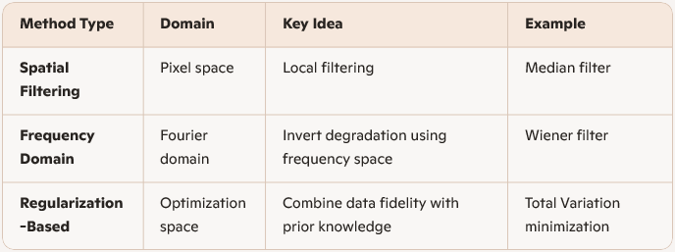
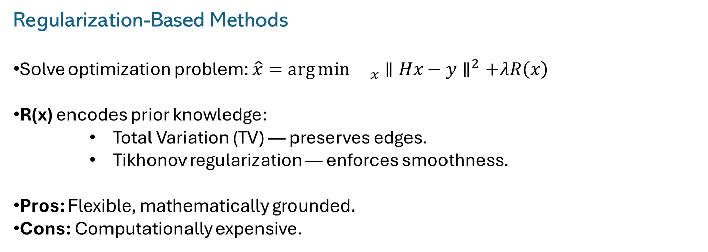
Regularization-Based Methods
Solve optimization problem: $\hat{x}=\arg{{\min{}}_{x}}∥Hx−y∥^{2}+λR\left(x\right)$
R(x) encodes prior knowledge:
Total Variation (TV) — preserves edges.
Tikhonov regularization — enforces smoothness.
Pros: Flexible, mathematically grounded.
Cons: Computationally expensive.
Summary Table

Slide 30
Why Move Beyond Classical Methods?
Limitations of Classical Image Restoration
Require explicit mathematical priors (blur kernel, noise model).
Struggle with nonlinear, unknown, and real-world degradations.
Optimization-based — slow and not scalable for real-time 5G edge use.
Sensitive to parameter tuning; performance drops in complex scenes.

Slide 31
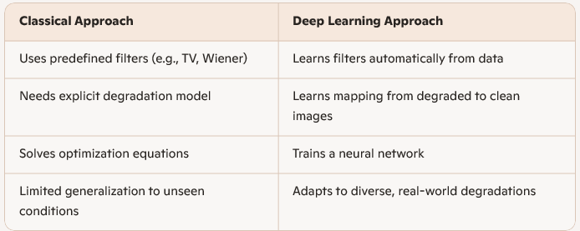
The Shift: From Handcrafted Priors to Data-Driven Learning
“Classical models restore images mathematically
— Deep Learning restores them intelligently.”

Slide 32
Deep Learning Enters — CNN Era
A Paradigm Shift
• Classical filters relied on hand-crafted rules.
• Deep learning introduced data-driven learning for image restoration.
• Convolutional Neural Networks (CNNs) became the backbone of this revolution.
Key Innovations
• End-to-End Learning: Networks learn to map noisy inputs to clean outputs directly.
• Feature Hierarchies: CNNs extract multi-scale features — from edges to textures.
• Residual Learning: Techniques like DnCNN use residuals to simplify training and boost performance.
Advantages Over Classical Filters
• Learns complex noise patterns from data.
• Preserves fine details and textures.
• Generalizes across diverse degradation types.
Milestone Models
• DnCNN: Residual CNN for Gaussian denoising.
• IRCNN: Combines model-based priors with CNNs.
• FFDNet: Handles variable noise levels with a noise map input.

Slide 33
Convolutional Neural Networks (CNNs) – History & Overview
Origin
Inspired by human visual cortex (Hubel & Wiesel).
Early model: Neocognitron (1980).
Milestones
LeNet-5 (1998): Digit recognition.
AlexNet (2012): ImageNet breakthrough.
VGGNet (2014), ResNet (2015): Deeper, more stable CNNs.
Architecture
Convolutions: Local feature extraction.
Pooling: Downsampling + invariance.
Fully Connected: Final predictions.
Why for Image Restoration
Captures spatial and hierarchical patterns.
Weight sharing → efficient learning.
Strong performance in denoising, deblurring, super-resolution, inpainting.
“While CNNs are conventionally used for object detection and classification, in this project CNNs are leveraged for low-level vision tasks such as denoising and deblurring, where spatial feature extraction is equally important.”

Slide 34
But CNNs had limits…
Local Receptive Field: Weak at capturing global context.
Over-Smoothing: MSE-like losses blur fine details.
Real-World Degradations: Struggles with unknown or mixed noise/blur.
High Computation: Deep models need heavy memory and training time.
Weak Generalization: Good on synthetic data; poor on real images.
No Non-Local Modeling: Misses repeating textures/patterns.
Data Hungry: Needs large clean–distorted pairs.
Perceptual Gap: Optimizes pixels, not human visual quality.
Hyperparameter Sensitive: Training settings highly impactful.
Low Interpretability: Difficult to understand model decisions.

Slide 35
Transformers — the new brain for vision
A New Frontier
CNNs capture local features but miss long-range dependencies.
Transformers add global attention, enabling deeper contextual understanding.
Core Concepts
Self-Attention: Relates every pixel/patch to every other.
Patch Embedding: Image → patches → tokens (NLP-style).
Scalability: Larger data/models → stronger representations.
Advantages Over CNNs
Models global context effectively.
Flexible architecture with fewer built-in biases.
Strong results in denoising, deblurring, and super-resolution.
Landmark Models
ViT: Patch-based Transformer for vision.
SwinIR: Hierarchical Transformer for restoration.
Restormer: Efficient, high-resolution restoration model.
Notes:
Here is a quick overview of what I'll be covering today.
I'll start with the business problem and my project's objectives.
Then, I'll walk you through the methodology used, from data exploration to the models I implemented.
After that, I'll present my key results and analysis, and I'll conclude with the practical impact of this work and directions for the future.

Slide 36
Transformers in Image Restoration – Evolution & Concepts`
Background
Originated in NLP: “Attention Is All You Need” (Vaswani et al., 2017).
Self-attention models long-range dependencies and global context.
Extended from ViT (2020) to low-level vision tasks: restoration, SR, denoising, etc.
Key Milestones
ViT (2020): First vision Transformer.
Swin Transformer (2021): Shifted-window, hierarchical features.
SwinIR (2021): Swin Transformer adapted for restoration.
Restormer (2022): Efficient global attention for high-res images.
Uformer (2022): U-shaped Transformer for multi-scale restoration.
Core Ideas
Self-Attention: Models global pixel/patch relationships.
Hierarchical Design: Blends local + global context efficiently.
Hybrid Models: Combine CNN locality with Transformer global reasoning.
Why Transformers for Restoration
Capture global dependencies beyond CNN’s local receptive field.
Handle diverse degradations (denoising, deblurring, deraining, SR).
Deliver state-of-the-art results on DIV2K, GoPro, SIDD, and more.

Slide 37
Limitations of Transformer-Based Image Restoration Models
High Computational Cost: Quadratic attention makes memory usage heavy and training slow.
Data Hungry: Require large, high-quality datasets to effectively learn global dependencies.
Weak Local Detail Capture: May miss fine textures and edges compared to CNNs.
Training Instability: Highly sensitive to hyperparameters and can diverge without careful tuning.
Overfitting Risk: Large model capacity often leads to poor generalization on small datasets.
Slow Inference: Processing high-resolution images is computationally expensive.
Architectural Complexity: Balancing performance and efficiency requires complex design choices.
Limited Interpretability: Attention patterns are difficult to visualize or meaningfully explain.
Resource Intensive: Hard to deploy on edge devices or real-time applications due to high compute demands.

Slide 38
Part 2: Methodology - Hybrid CNN–Transformer Restoration

Slide 39
Objective & Data Preparation
Objective Develop a lightweight Hybrid CNN–Transformer model for real-time restoration of degraded images on 5G edge devices.
Data Preparation
Collect degraded images from IoT/Edge camera simulations under low-bandwidth 5G conditions.
Use benchmark datasets: SIDD, GoPro, DIV2K.
Apply realistic synthetic degradations:
Noise: Gaussian, Poisson
Blur: Motion, defocus
Compression: JPEG artifacts, packet-loss distortions
Normalize images, extract patches, and apply augmentation (rotation, scaling, low-light).

Slide 40
CNN Feature Extraction
Why CNN? Efficient at learning local, pixel-level details and edges with low compute overhead.
Method
Use shallow depthwise separable convolutions to extract fine edge and texture features.
Acts as a local feature encoder suitable for real-time edge use.
Preserves structural patterns critical for denoising, deblurring, and artifact removal.
Output
Set of local feature maps forwarded to Transformer blocks for global refinement.

Slide 41
Transformer Attention & Fusion
Efficient Transformer Attention
Use windowed self-attention to model long-range dependencies at reduced complexity.
Apply LayerNorm + GELU for stable training on high-resolution patches.
CNN–Transformer Fusion
Combine local clarity (CNN) with global consistency (Transformer) using adaptive fusion layers.
Use skip connections to retain fine textures and reduce over-smoothing.
Produces a balanced latent representation for high-quality restoration.

Slide 42
Restoration, Deployment & Evaluation
Restoration Head
Lightweight reconstruction using pixel shuffle / upsampling layers.
Outputs enhanced, sharp, and artifact-free images.
Edge Deployment based on feasibility
Model compression via quantization + pruning for low-power devices.
Deployable on Raspberry Pi, Jetson Nano, mobile edge accelerators.
Evaluation Metrics
Quality: PSNR, SSIM, NIQE, BRISQUE
Efficiency: Latency (ms), FLOPs, memory usage
Validation: Visual comparison before vs. after restoration

Slide 43
Part 3: Result & Analysis
Notes:
"Now, let's move on to the results of my experiments

Slide 44
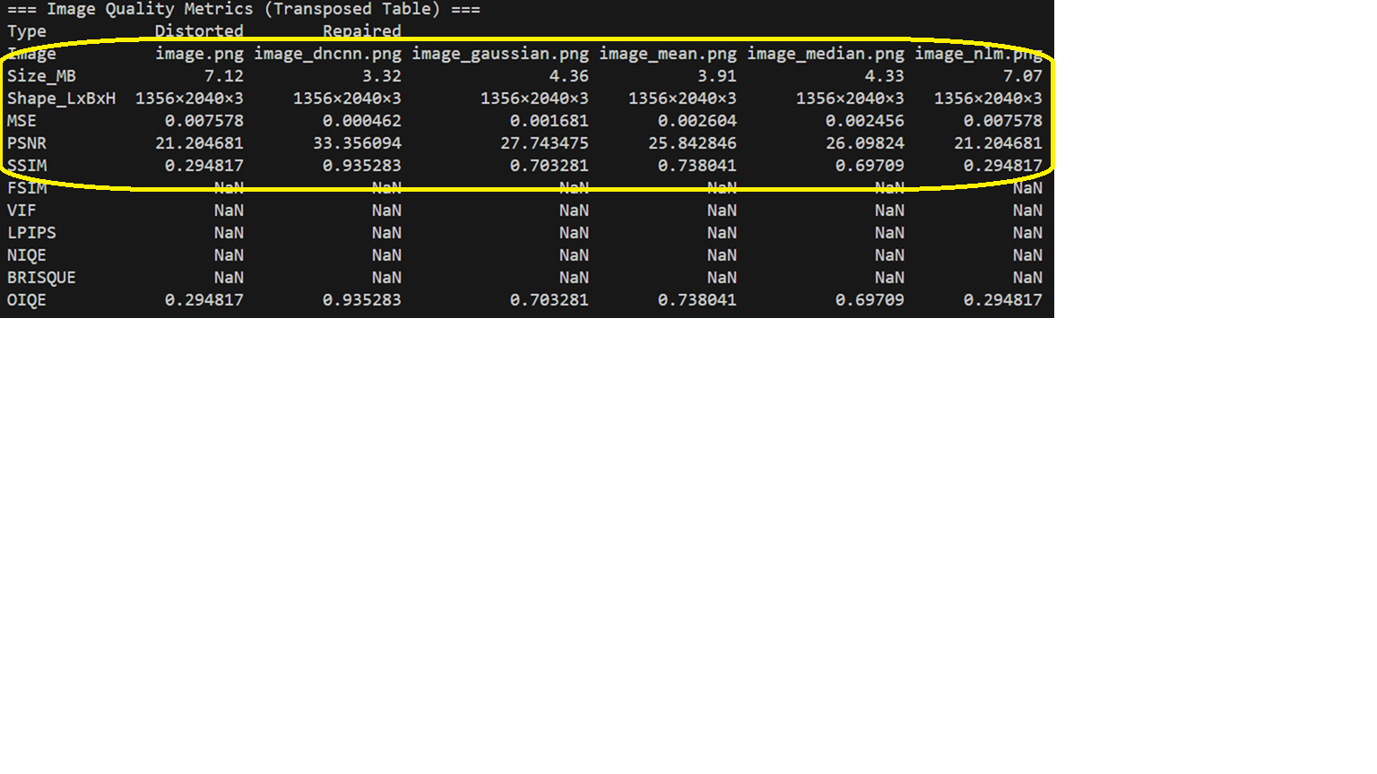
Baseline - Comparison of Image Restoration Methods (Classical vs DnCNN)

Slide 45
So Far & Next Steps
Train CNN-Transformer Model

Slide 46
References
Li, F.-F., Johnson, J., & Karpathy, A. (n.d.). CS231n: Deep learning for computer vision. Stanford University. Retrieved November 7, 2025, from http://cs231n.stanford.edu/
Vaswani, A., Shazeer, N., Parmar, N., Uszkoreit, J., Jones, L., Gomez, A. N., Kaiser, Ł., & Polosukhin, I. (2017). Attention is all you need. In Advances in Neural Information Processing Systems (Vol. 30). https://arxiv.org/abs/1706.03762
Dosovitskiy, A., Beyer, L., Kolesnikov, A., Weissenborn, D., Zhai, X., Unterthiner, T., Dehghani, M., Minderer, M., Heigold, G., Gelly, S., Uszkoreit, J., & Houlsby, N. (2021). An image is worth 16×16 words: Transformers for image recognition at scale. https://arxiv.org/abs/2010.11929
Zhang, K., Zuo, W., Chen, Y., Meng, D., & Zhang, L. (2017). Beyond a Gaussian denoiser: Residual learning of deep CNN for image denoising (DnCNN). In IEEE Conference on Computer Vision and Pattern Recognition (CVPR). https://doi.org/10.1109/CVPR.2017.163
Levin, A., Weiss, Y., Durand, F., & Freeman, W. T. (2009). Understanding and evaluating blind deconvolution algorithms. In IEEE Conference on Computer Vision and Pattern Recognition (CVPR). https://doi.org/10.1109/CVPR.2009.5206834
Dong, C., Loy, C. C., He, K., & Tang, X. (2014). Learning a deep convolutional network for image super-resolution (SRCNN). In European Conference on Computer Vision (ECCV). https://doi.org/10.1007/978-3-319-10593-2_13
Elad, M., Starck, J.-L., Querre, P., & Donoho, D. (2005). Simultaneous cartoon and texture image inpainting using morphological component analysis. Applied and Computational Harmonic Analysis, 19(3), 340–358. https://doi.org/10.1016/j.acha.2005.02.003
Dong, C., Loy, C. C., & Tang, X. (2015). Compression artifacts reduction by a deep convolutional network. In IEEE International Conference on Computer Vision (ICCV). https://doi.org/10.1109/ICCV.2015.333
Debevec, P., & Malik, J. (1997). Recovering high dynamic range radiance maps from photographs. In Proceedings of SIGGRAPH. https://doi.org/10.1145/258734.258884

